Slide 1


Library Management System
Team Name : The Sooners
Team Member: Sihon York
赵思豪 易宇
Vicky Vera
刘莉萍 刘佳薇

Slide 2

1. Team introduction
2. project brief
3. project structure
4. project display

Slide 3

Team introduction
Our team was founded on April 18, 2019, named Sooners, with four members, Sihon, York, Vicky, Vera. With the common dream and pursuit, as well as the love of learning, we have formed this united team. Our team slogan is: "where there is a will, there is a way. Our team has a strong spirit of exploration and desire for the unknown. Under the leadership of group leader Sihon, we have a clear division of labor, and we help each other and make progress together in the process. We met with many difficulties in doing this project. But our slogan guides us and makes us believe that we will succeed.

Slide 4
project brief
This is a management system for library, it can realize the automation of operation flow by electronic method, which replaces the traditional manual operation, thus reducing the workload of librarians. The library management system not only realizes the self-help loan and return of books, but also effectively reduces the friction between the administrator and the user. It effectively shortens the distance between books and users, reduces the dependence on librarians, and believes that our system will bring convenience to users and administrators.

Slide 5
project structure
Library Management System
Administrator Interface
User
Management
Book Management
User Interface
personal
Information
Report
System
Management
Change Password/
User name/
Address
Book Research
Borrowing
State

Slide 6

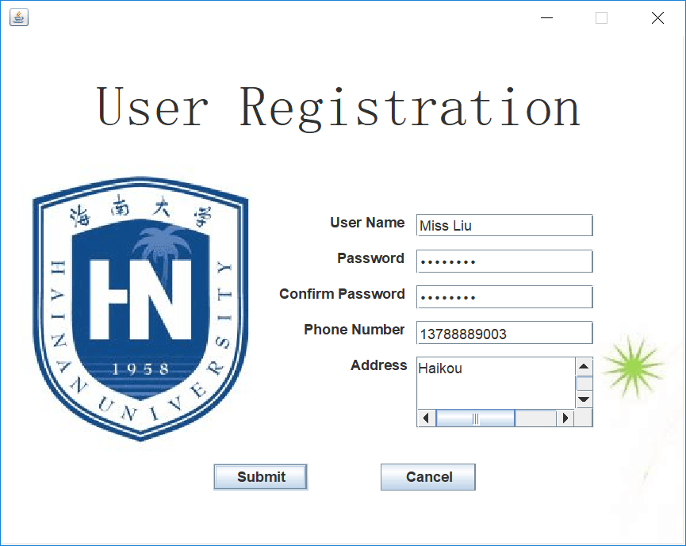
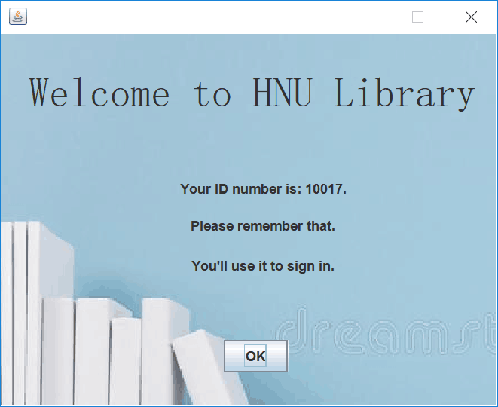
project display
user registration

Slide 7
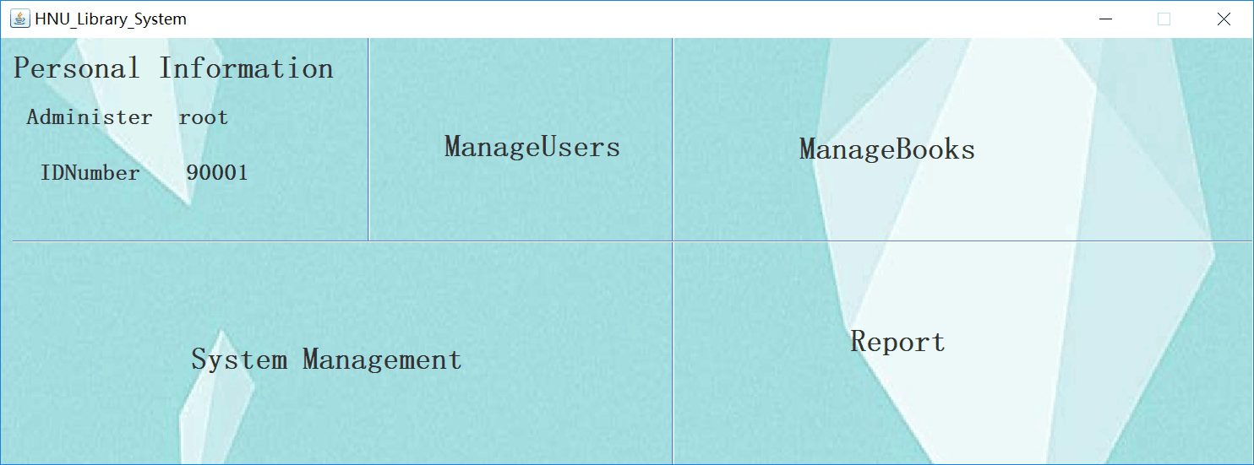
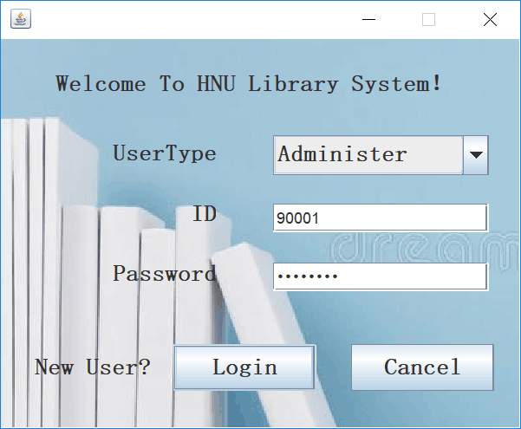
project display
Administrator login

Slide 8
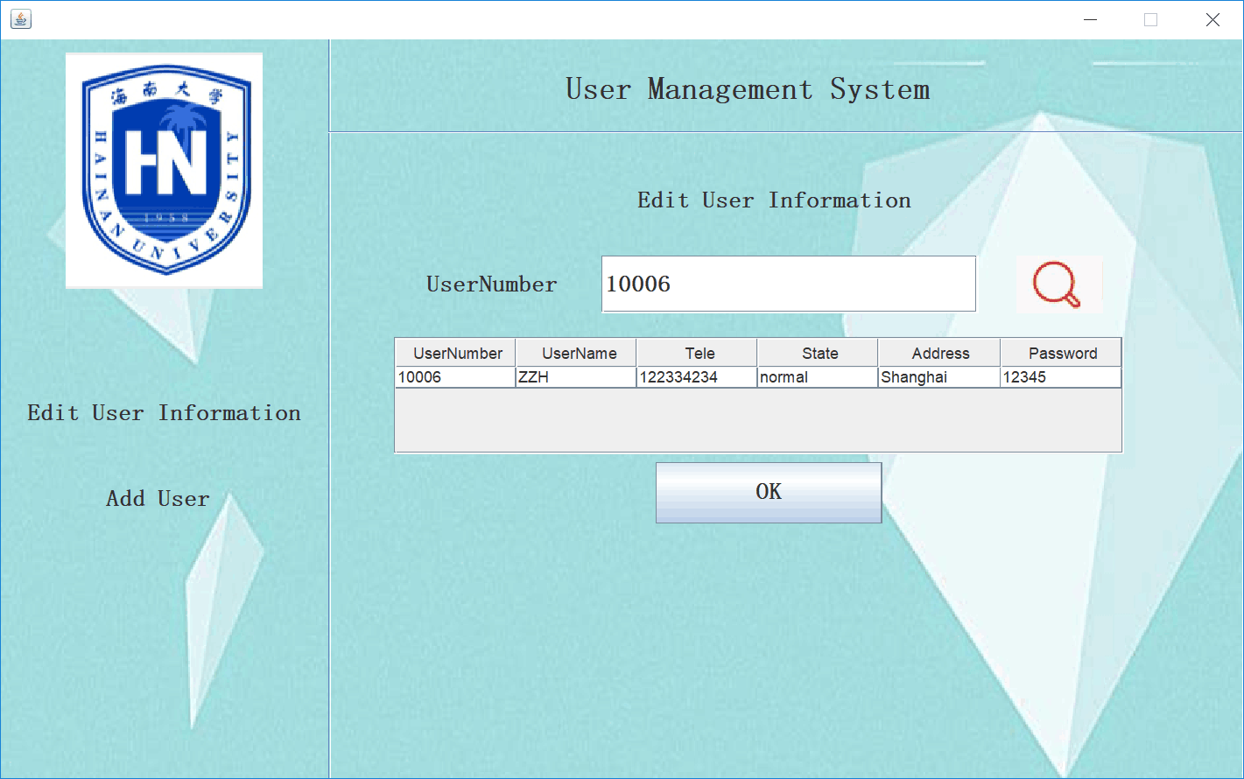
project display
user management

Slide 9
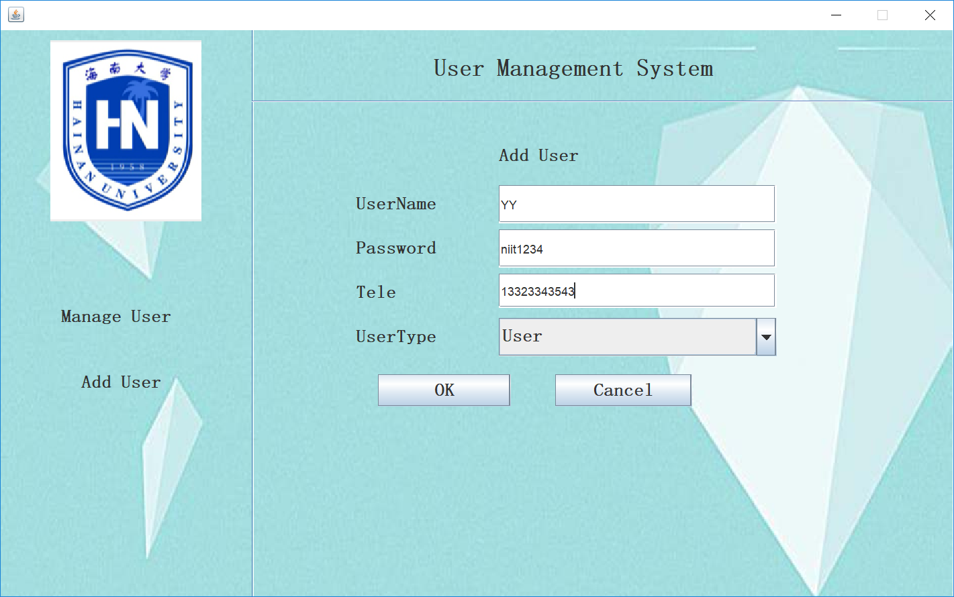
project display
user management

Slide 10
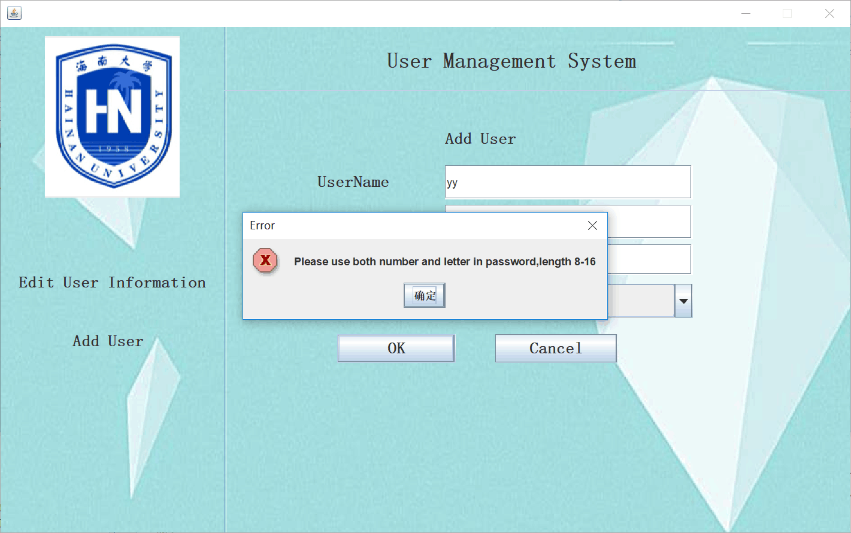
project display
user management

Slide 11
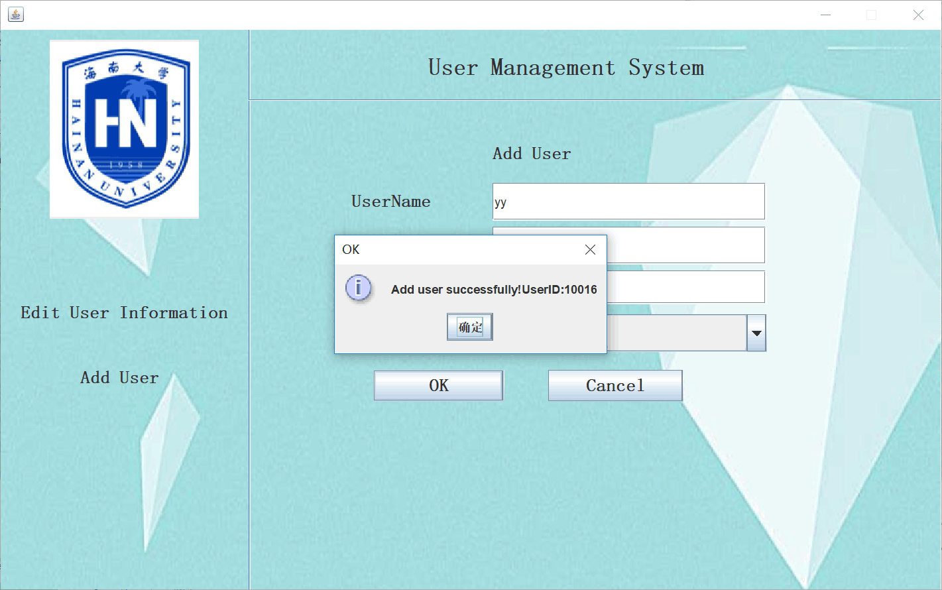
project display
user management

Slide 12
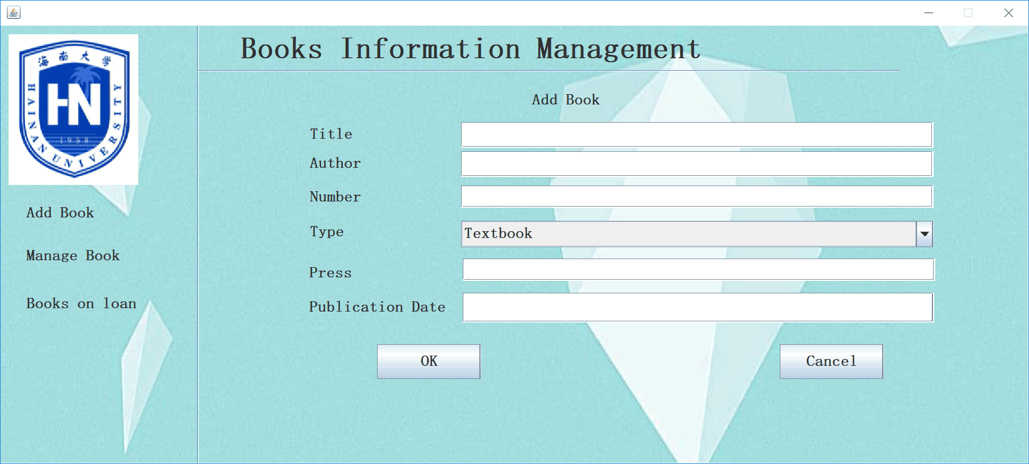
project display
Book management

Slide 13
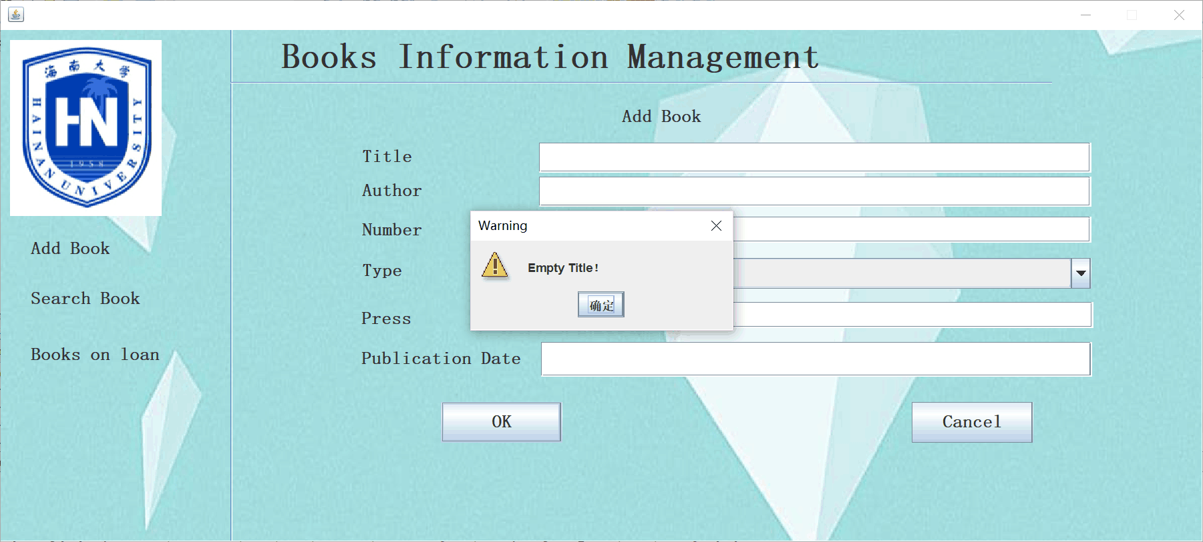
project display
Book management

Slide 14
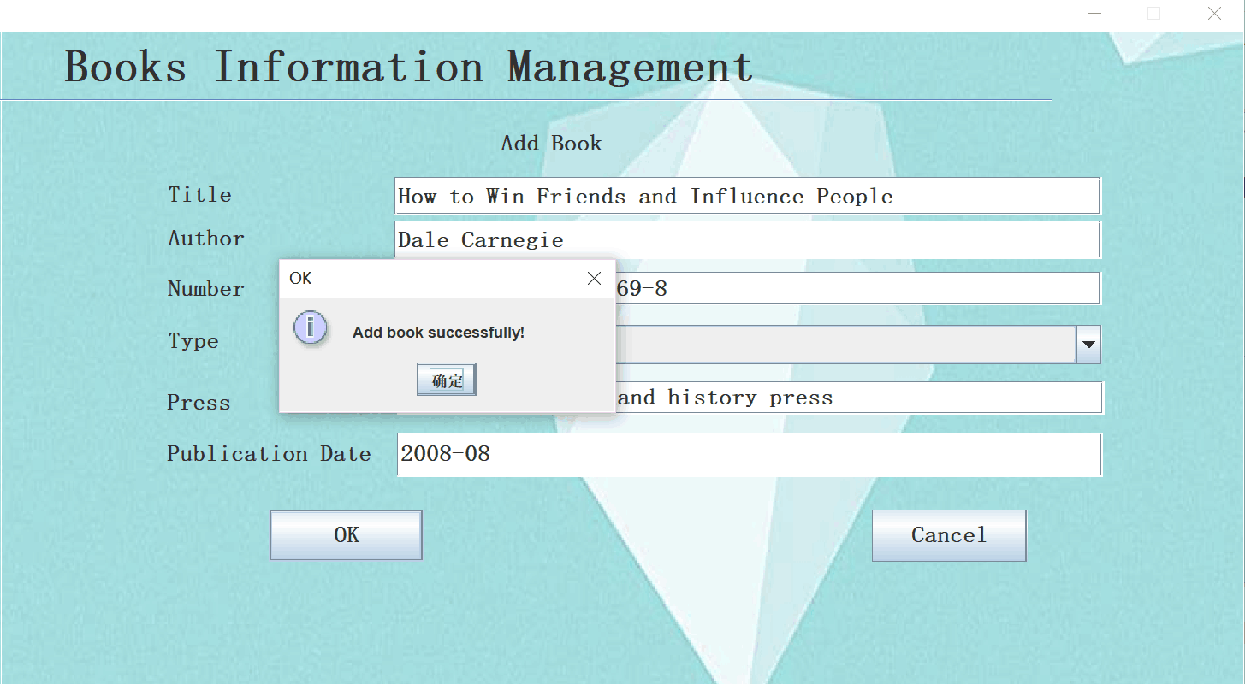
project display
Book management

Slide 15
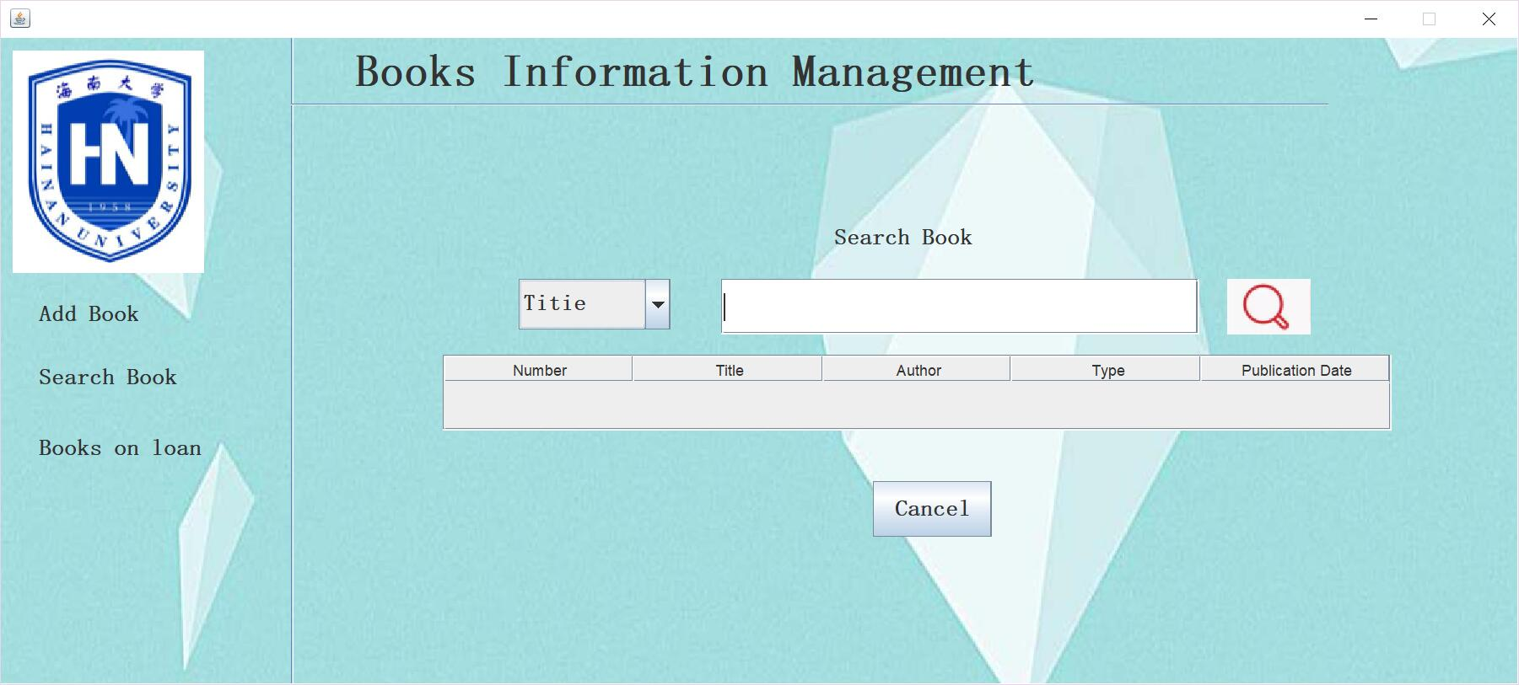
project display
Book management

Slide 16
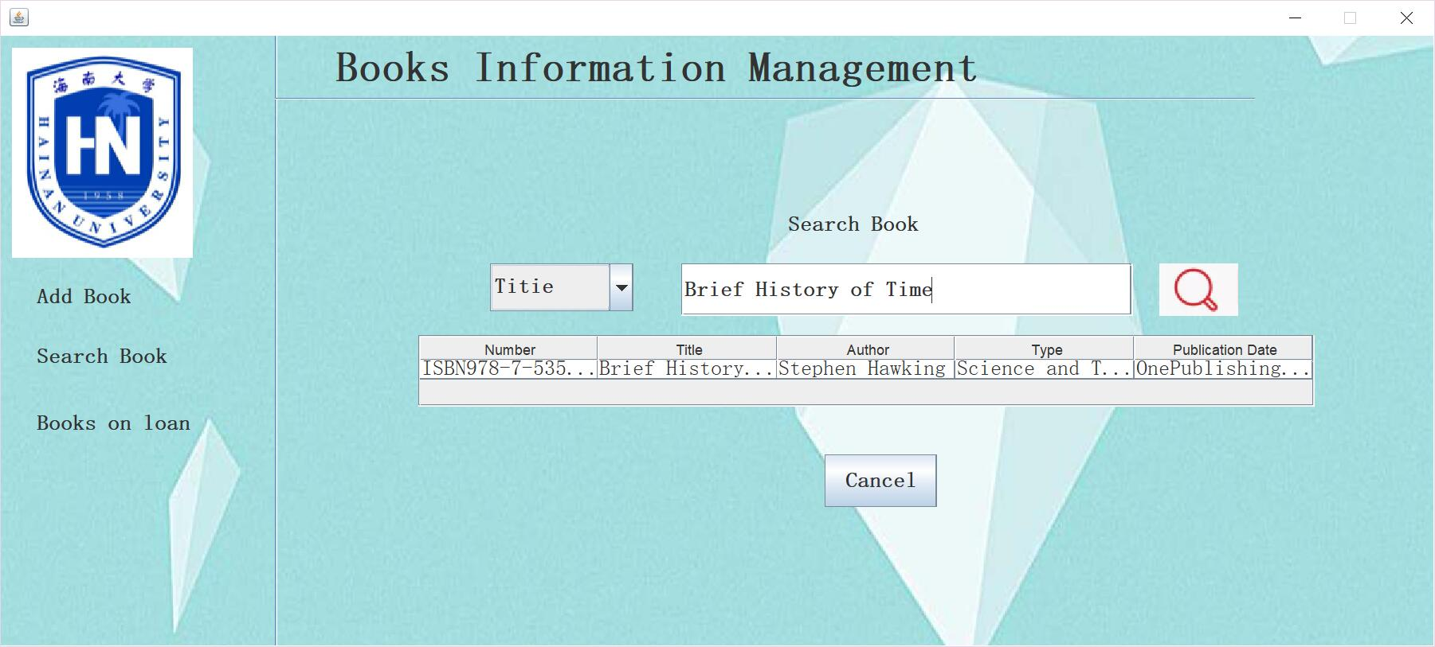
project display
Book management

Slide 17
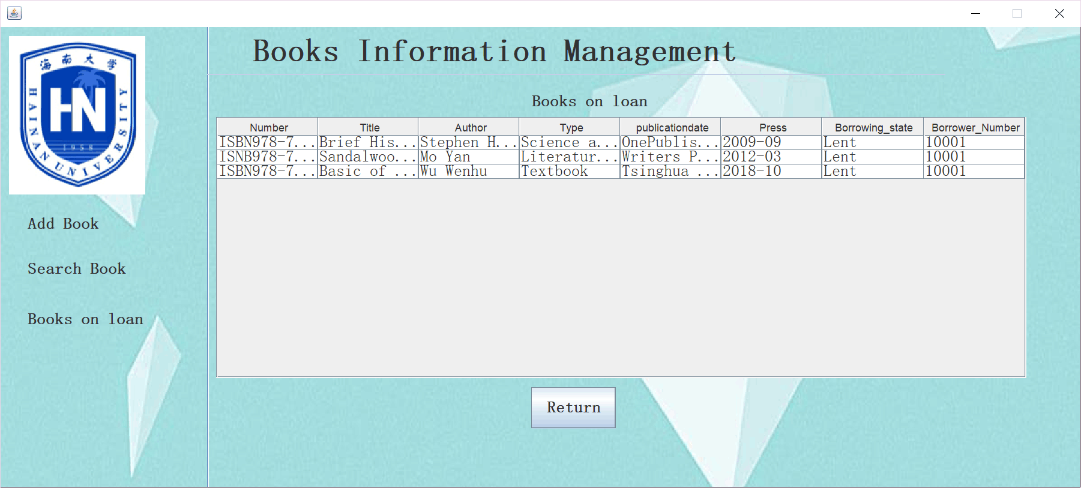
project display
Book management

Slide 18
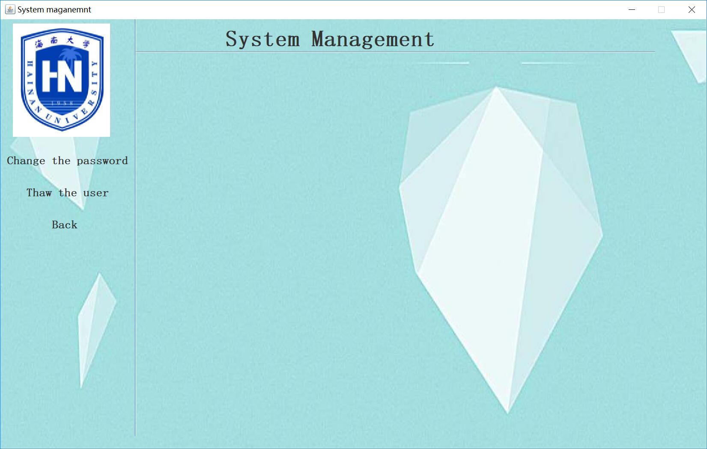
project display
System management

Slide 19
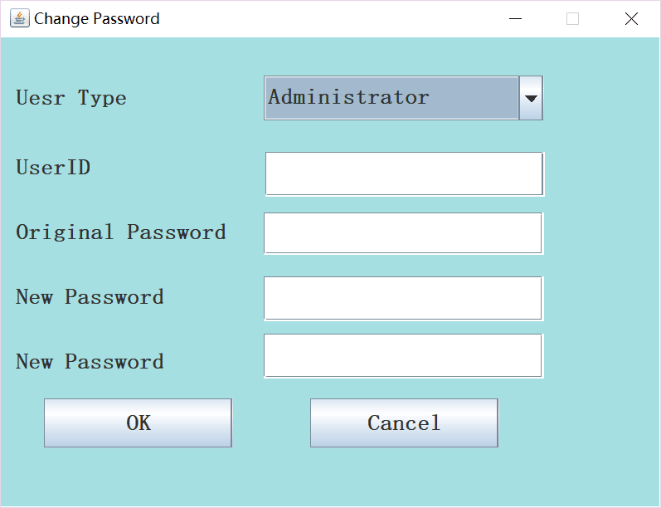
project display
System management

Slide 20
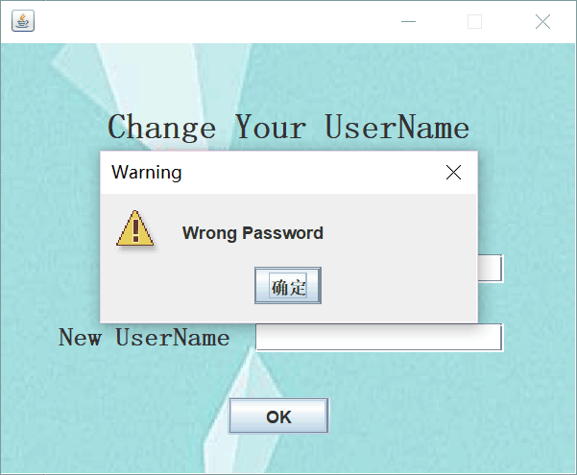
project display
System management

Slide 21
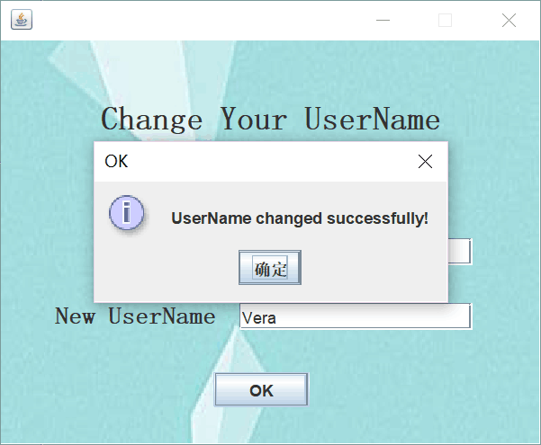
project display
System management

Slide 22
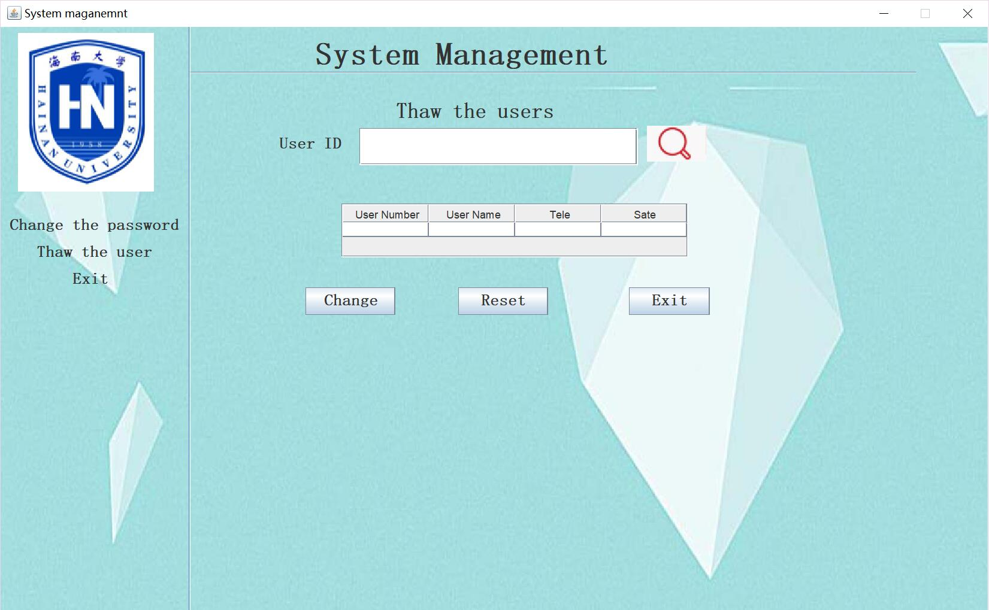
project display
System management

Slide 23
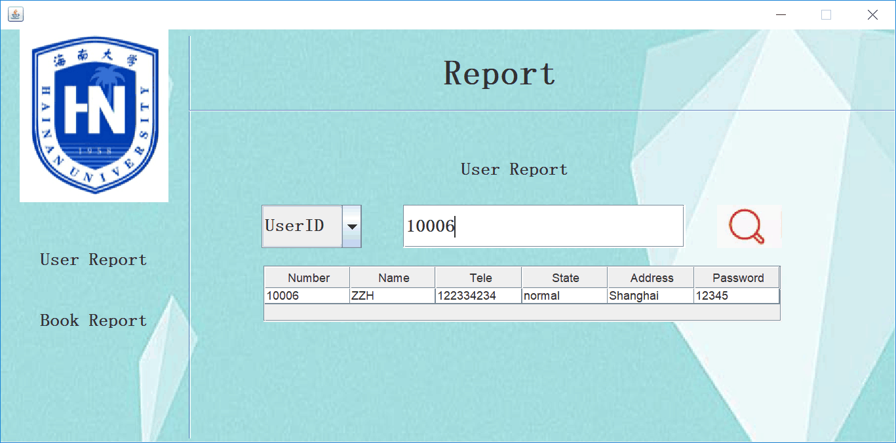
project display
Report

Slide 24
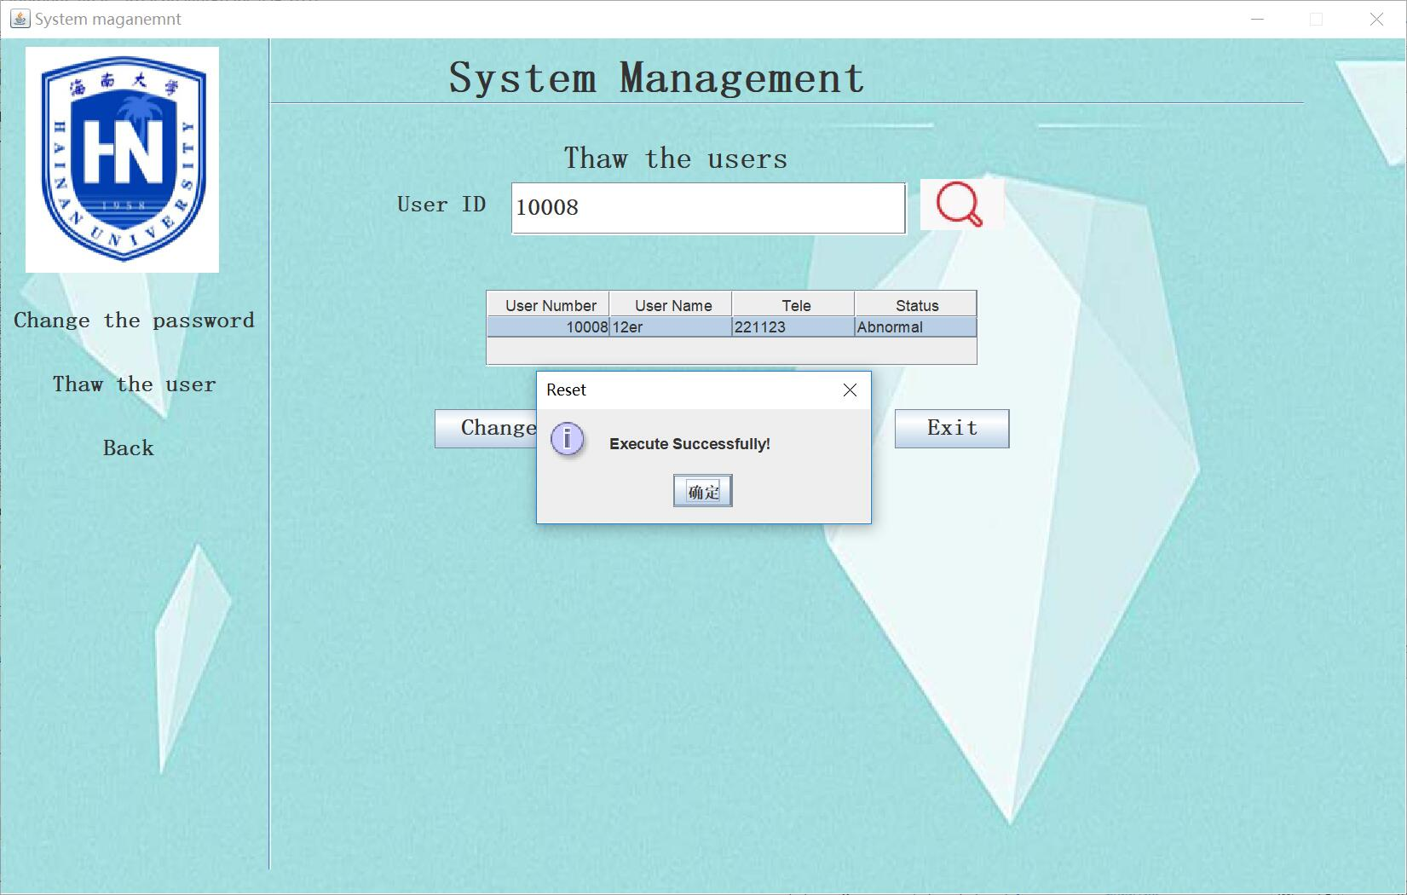
project display
Report

Slide 25
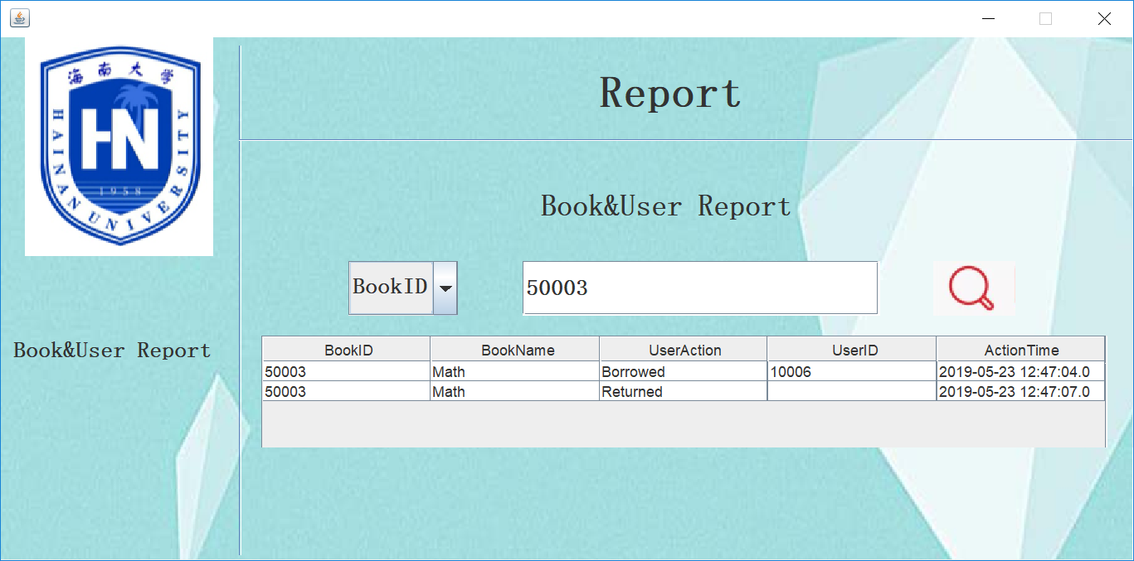
project display
Report

Slide 26
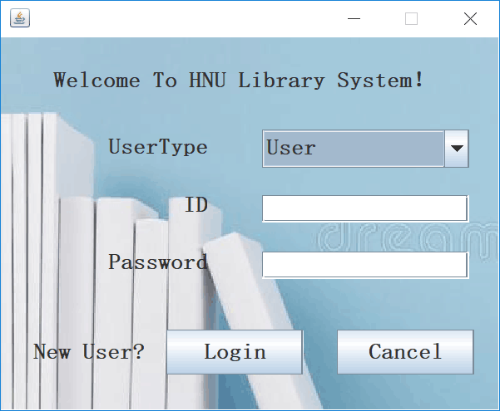
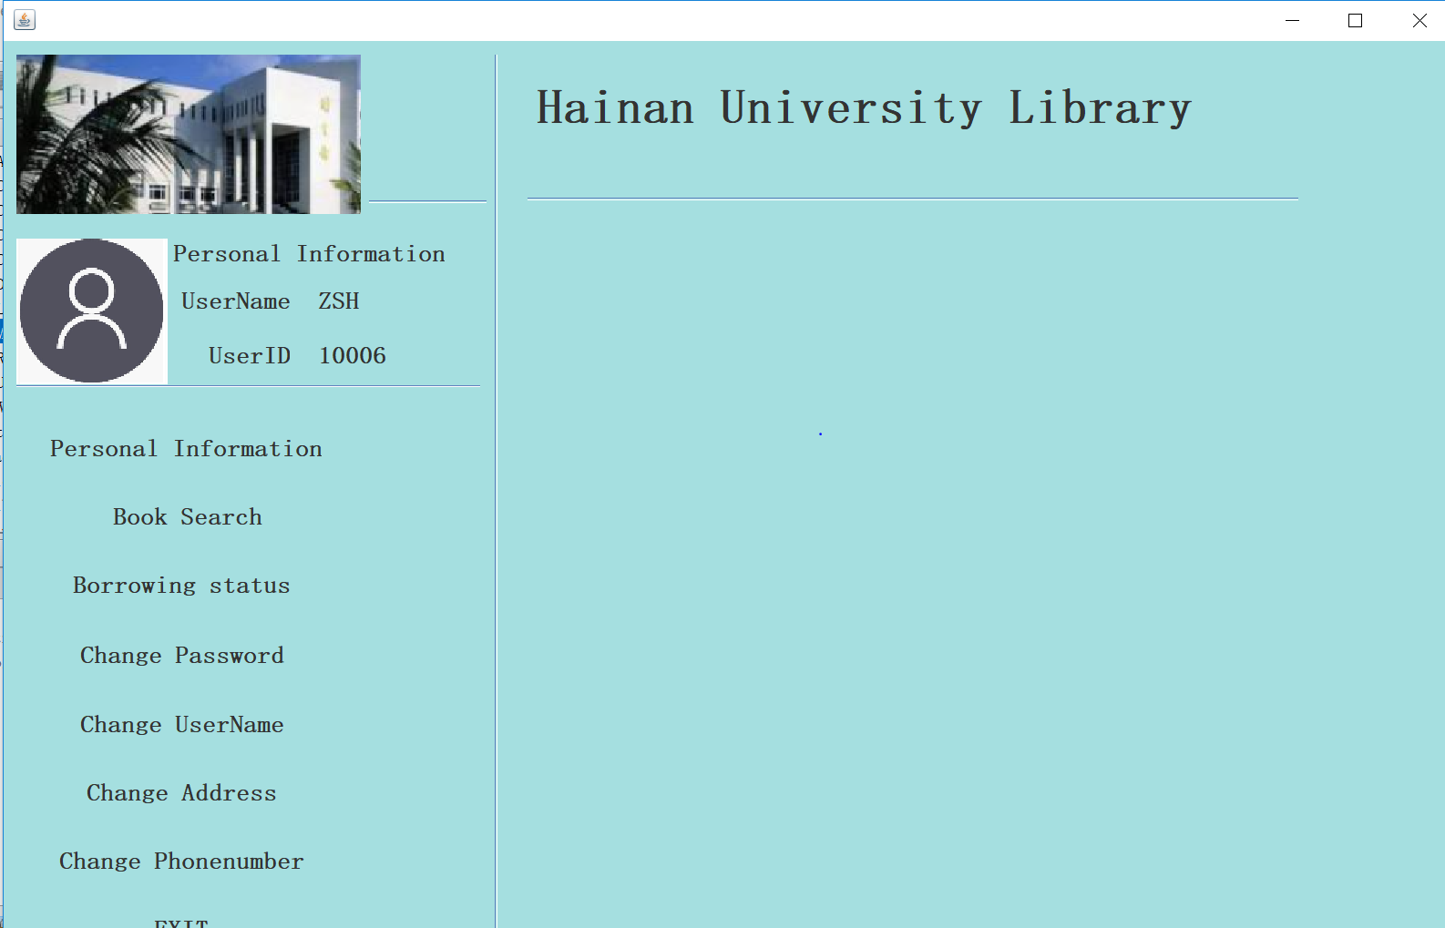
project display
User login

Slide 27
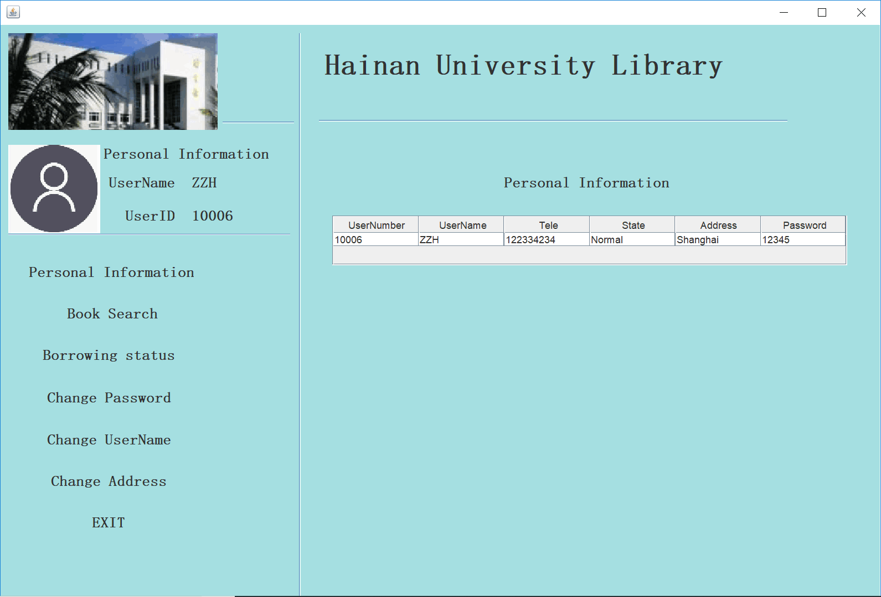
project display
Personal information

Slide 28
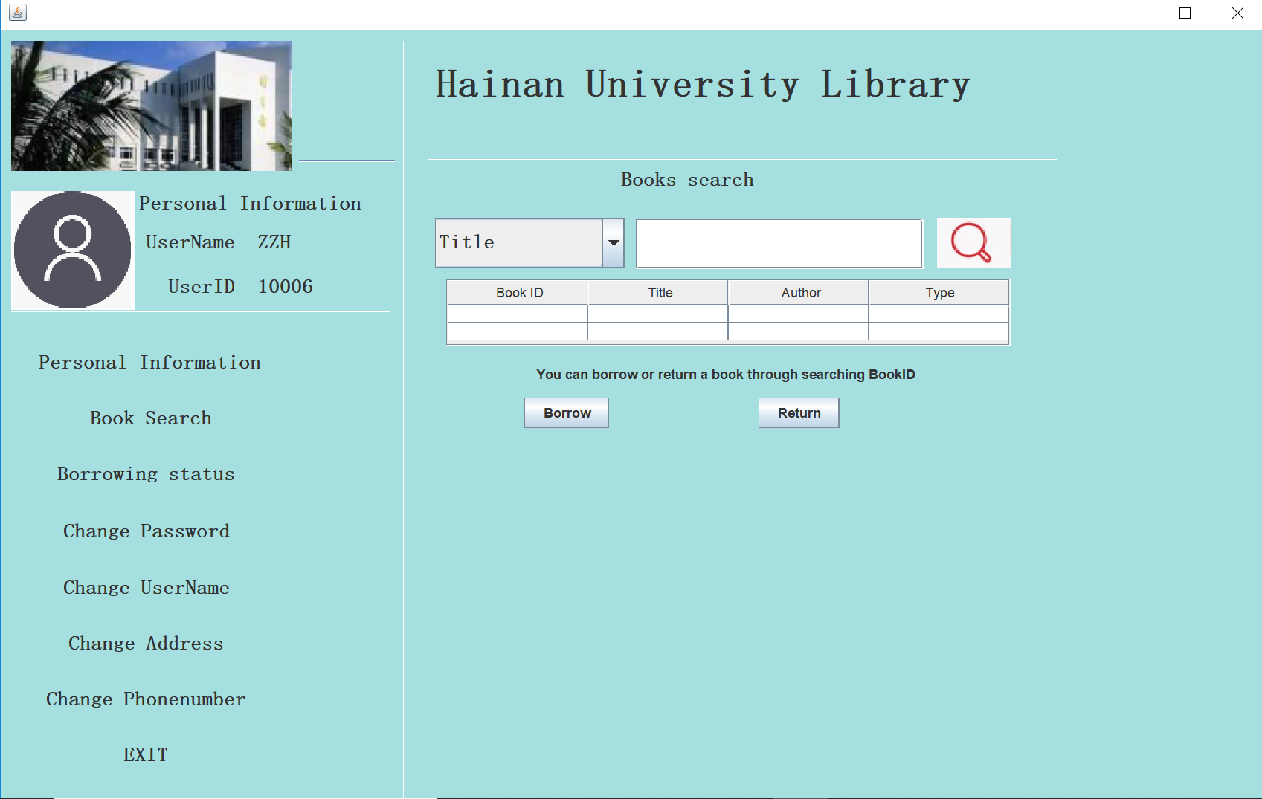
project display
Book search

Slide 29
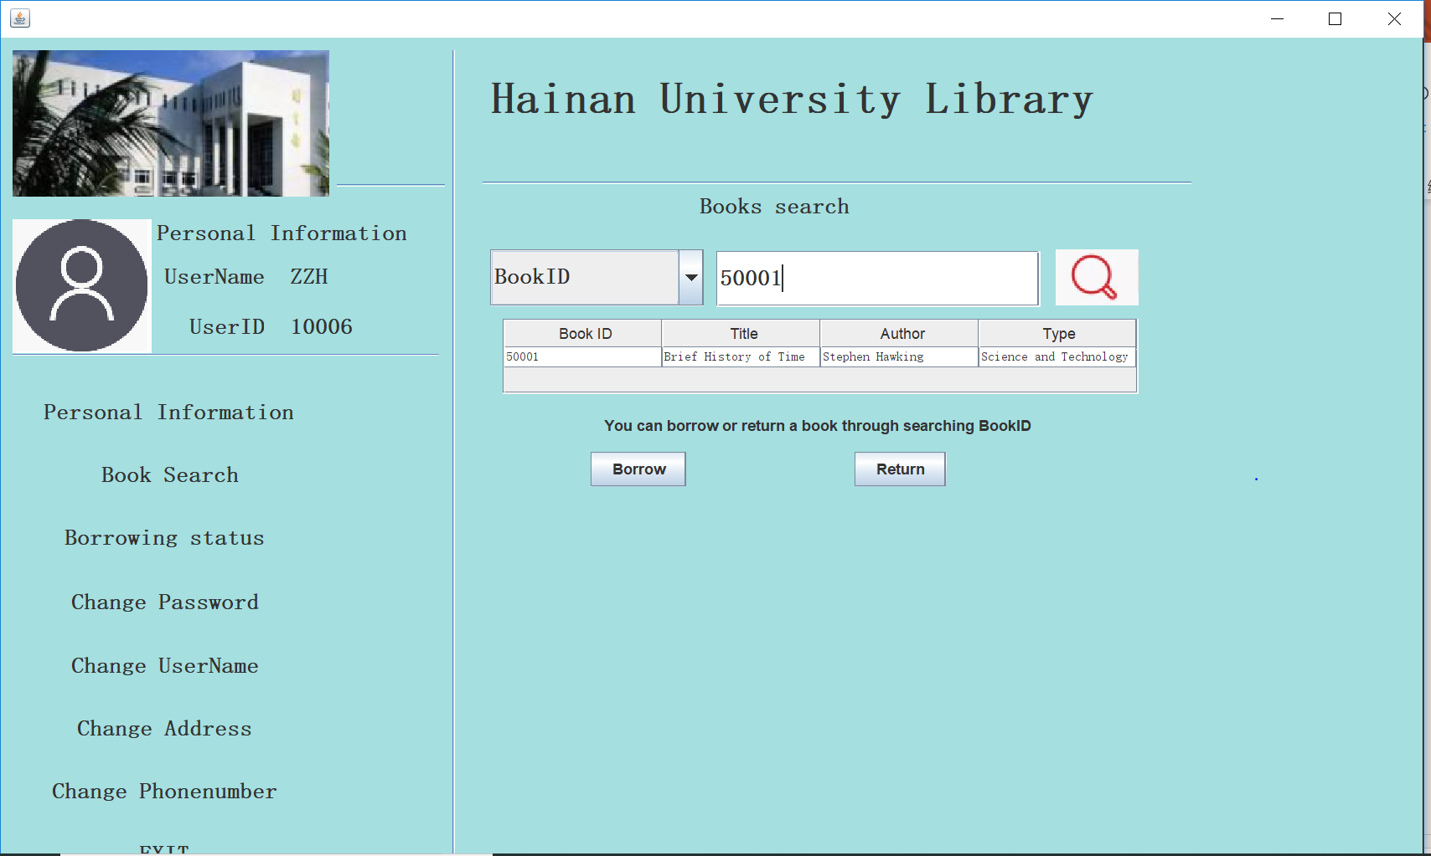
project display
Book search

Slide 30
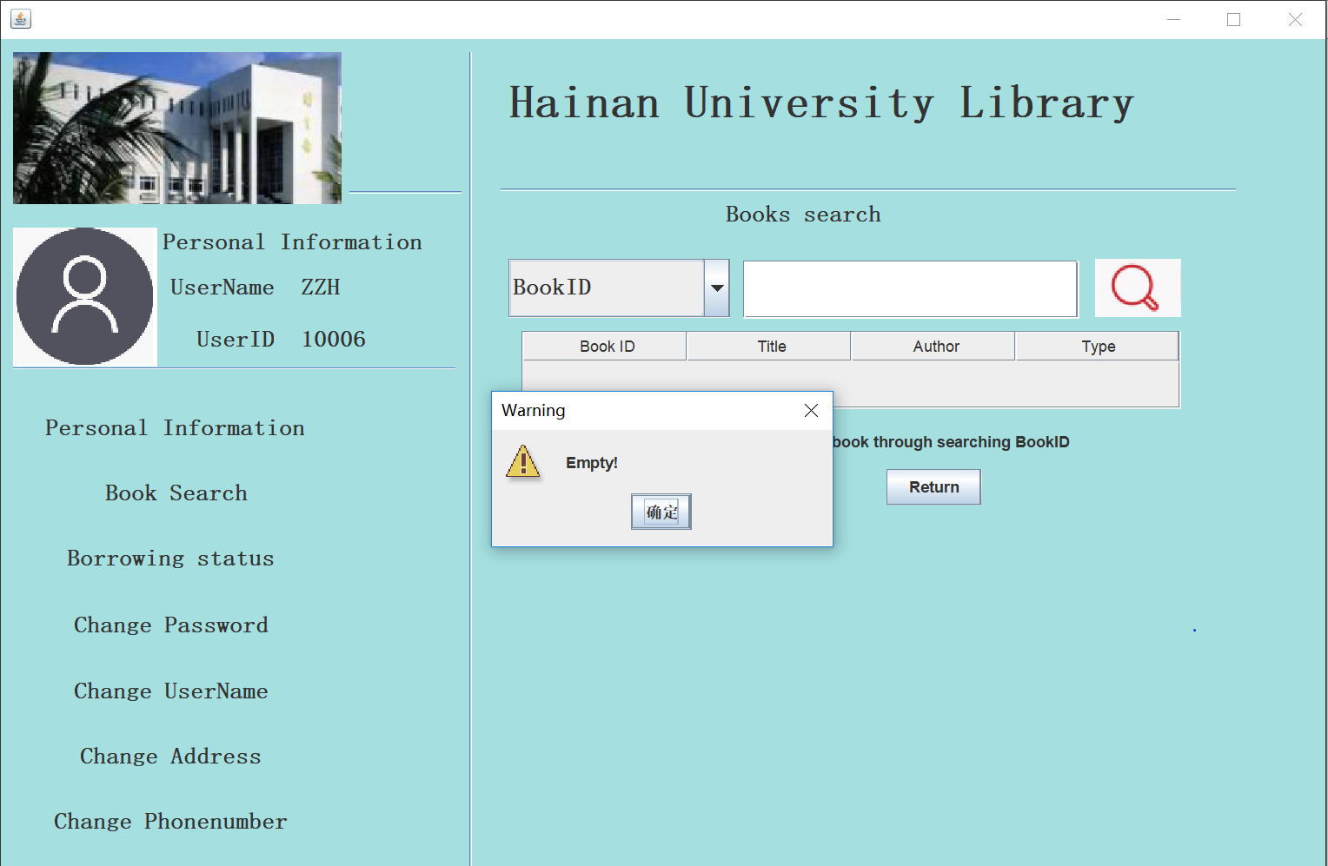
project display
Book search

Slide 31
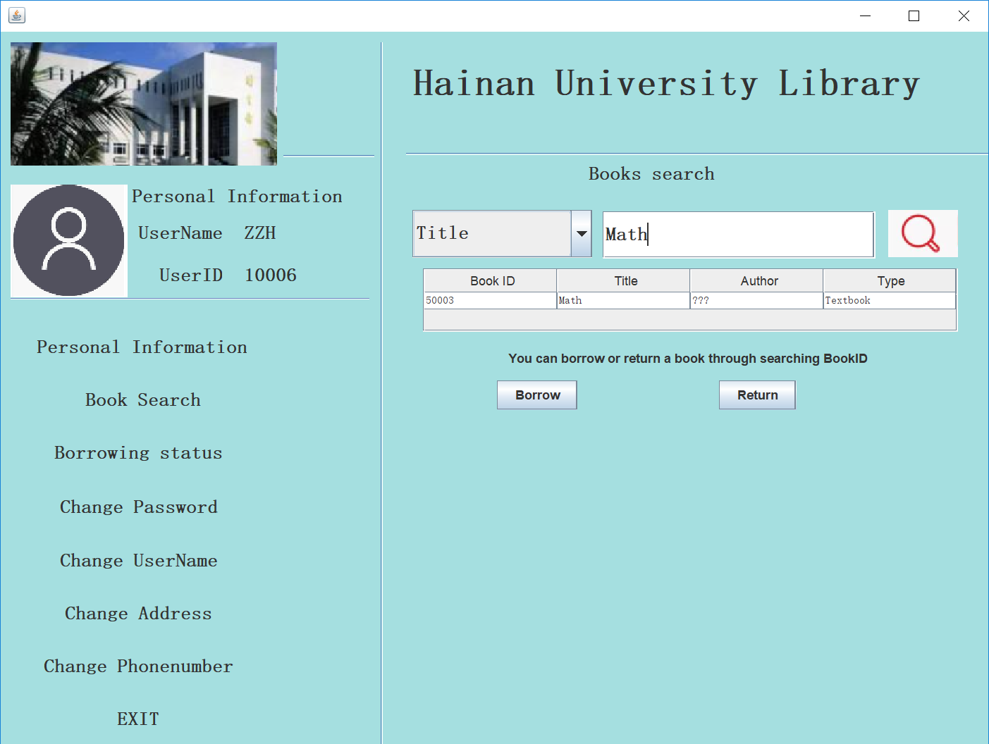
project display
Book search

Slide 32
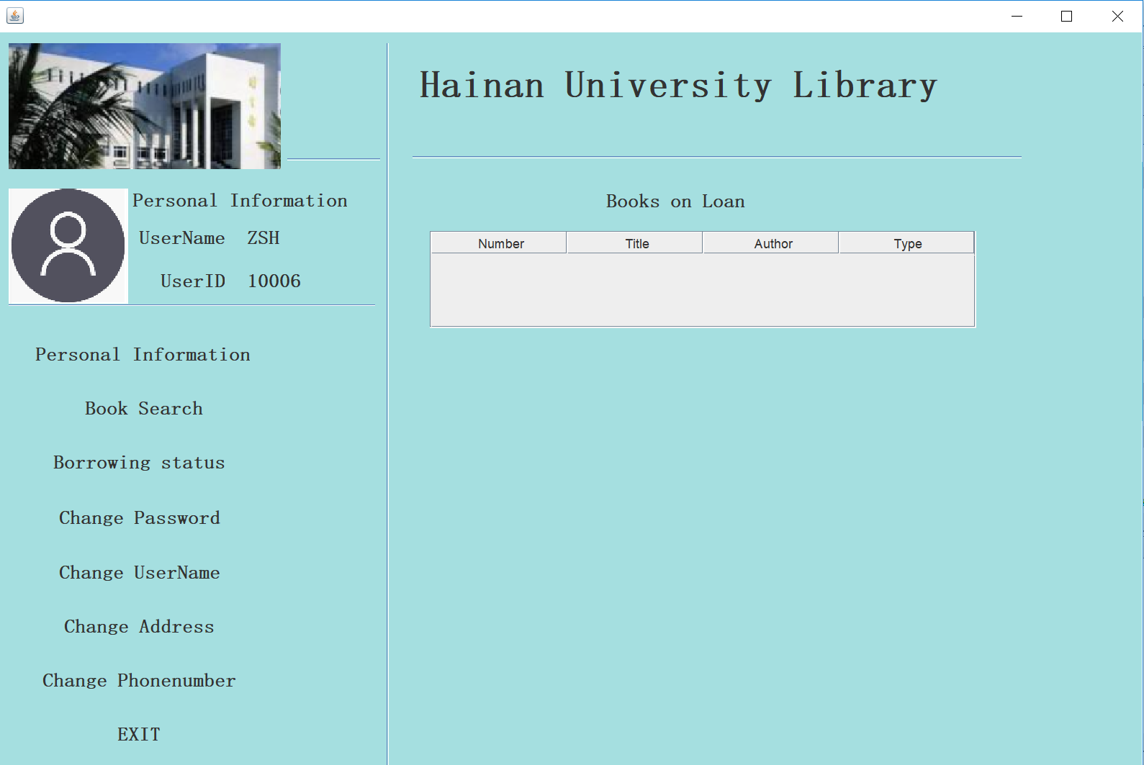
project display
Borrowing state

Slide 33
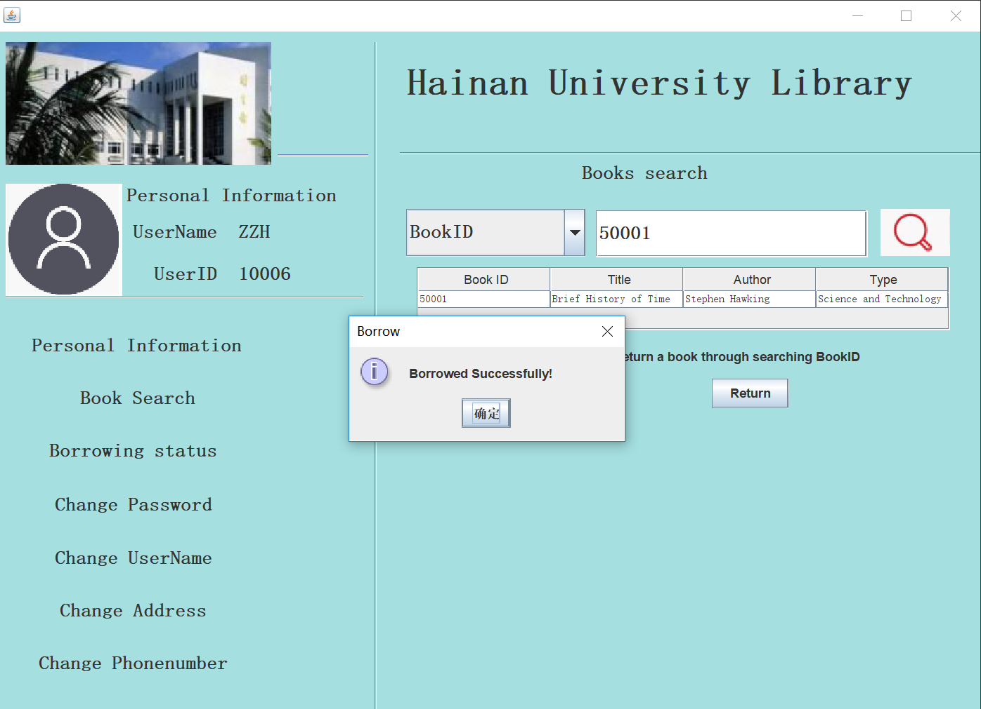
project display
Book search

Slide 34
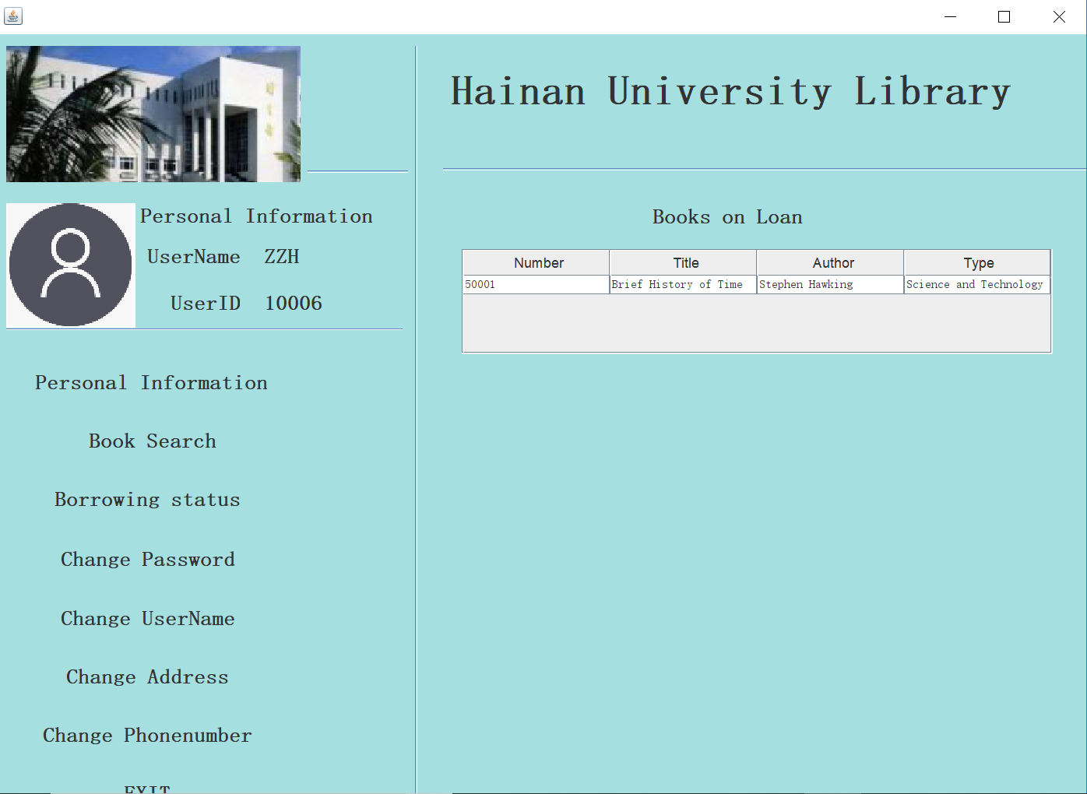
project display
Borrowing state

Slide 35
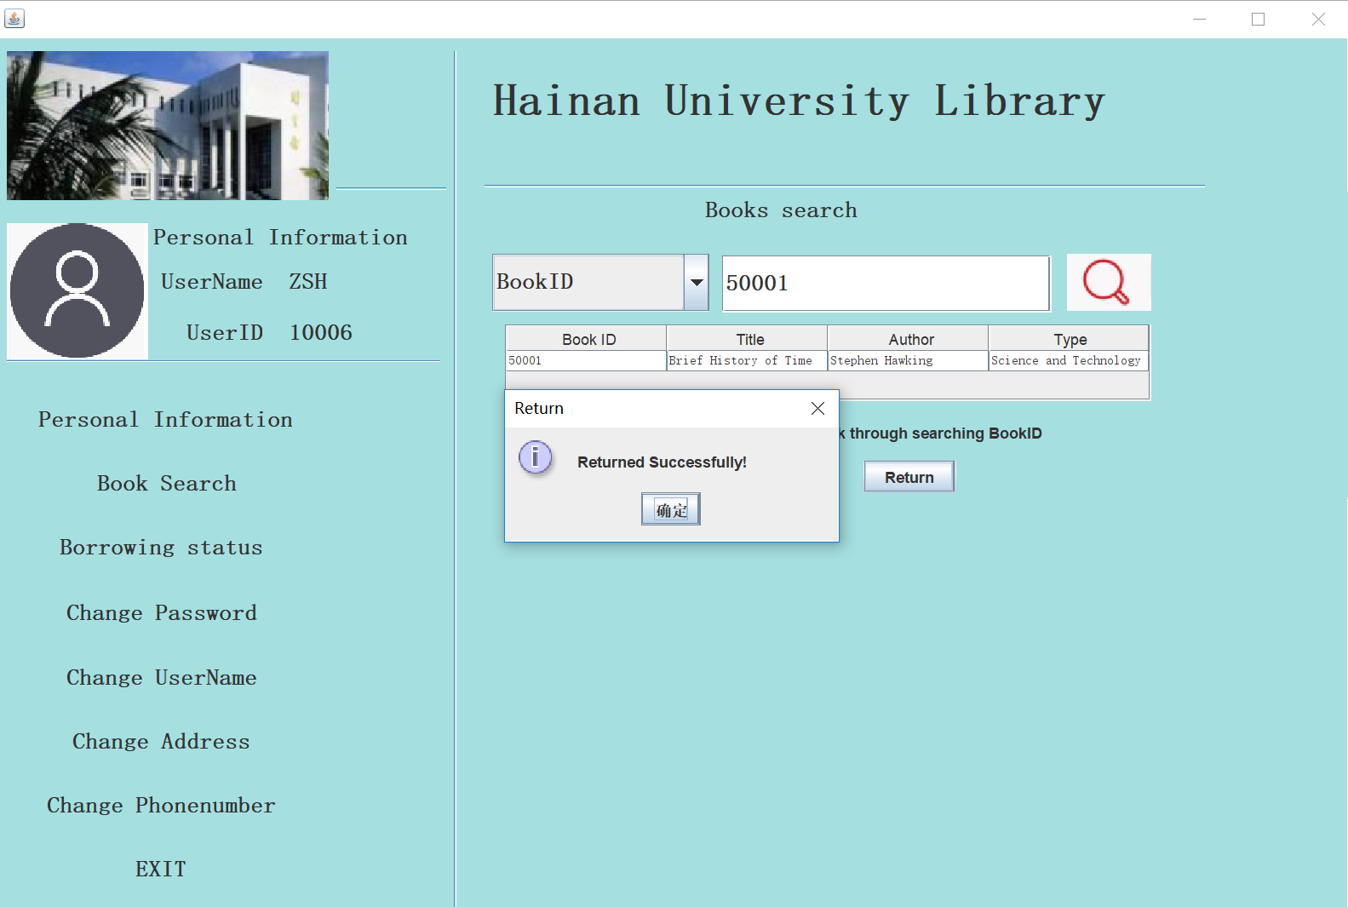
project display
Book search

Slide 36
project display
Borrowing state

Slide 37
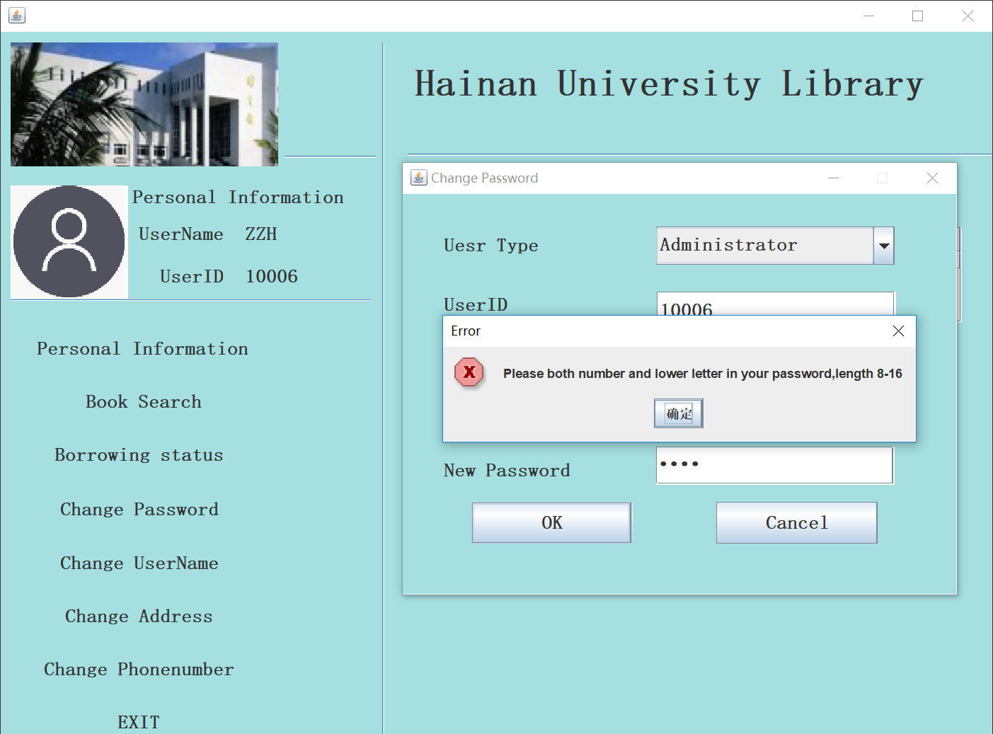
project display
Change password

Slide 38
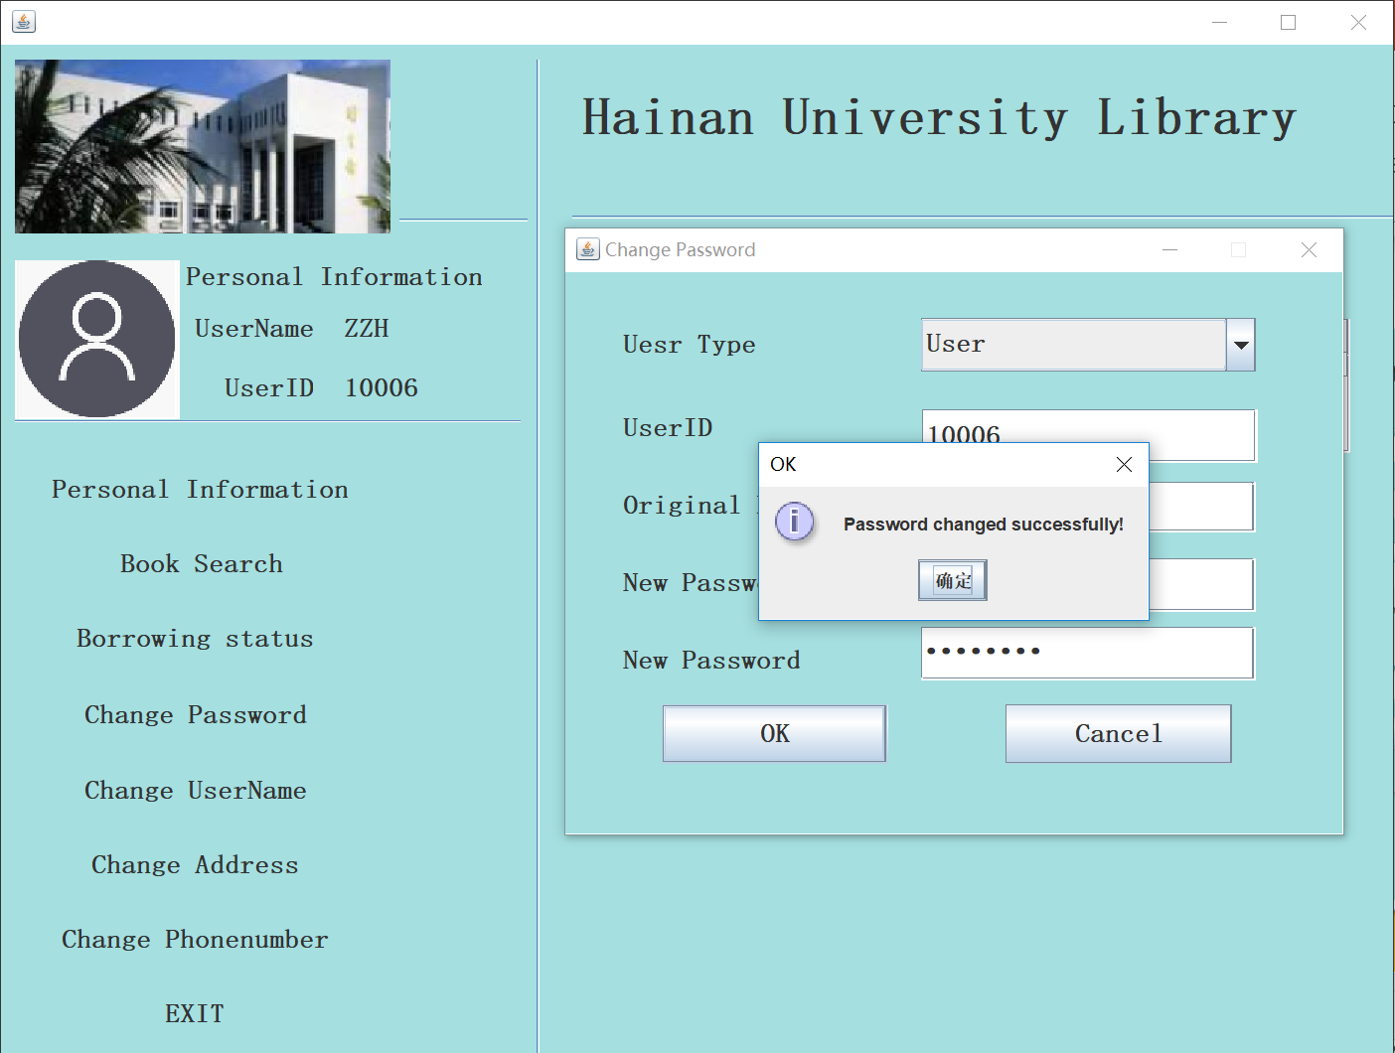
project display
Change password

Slide 39
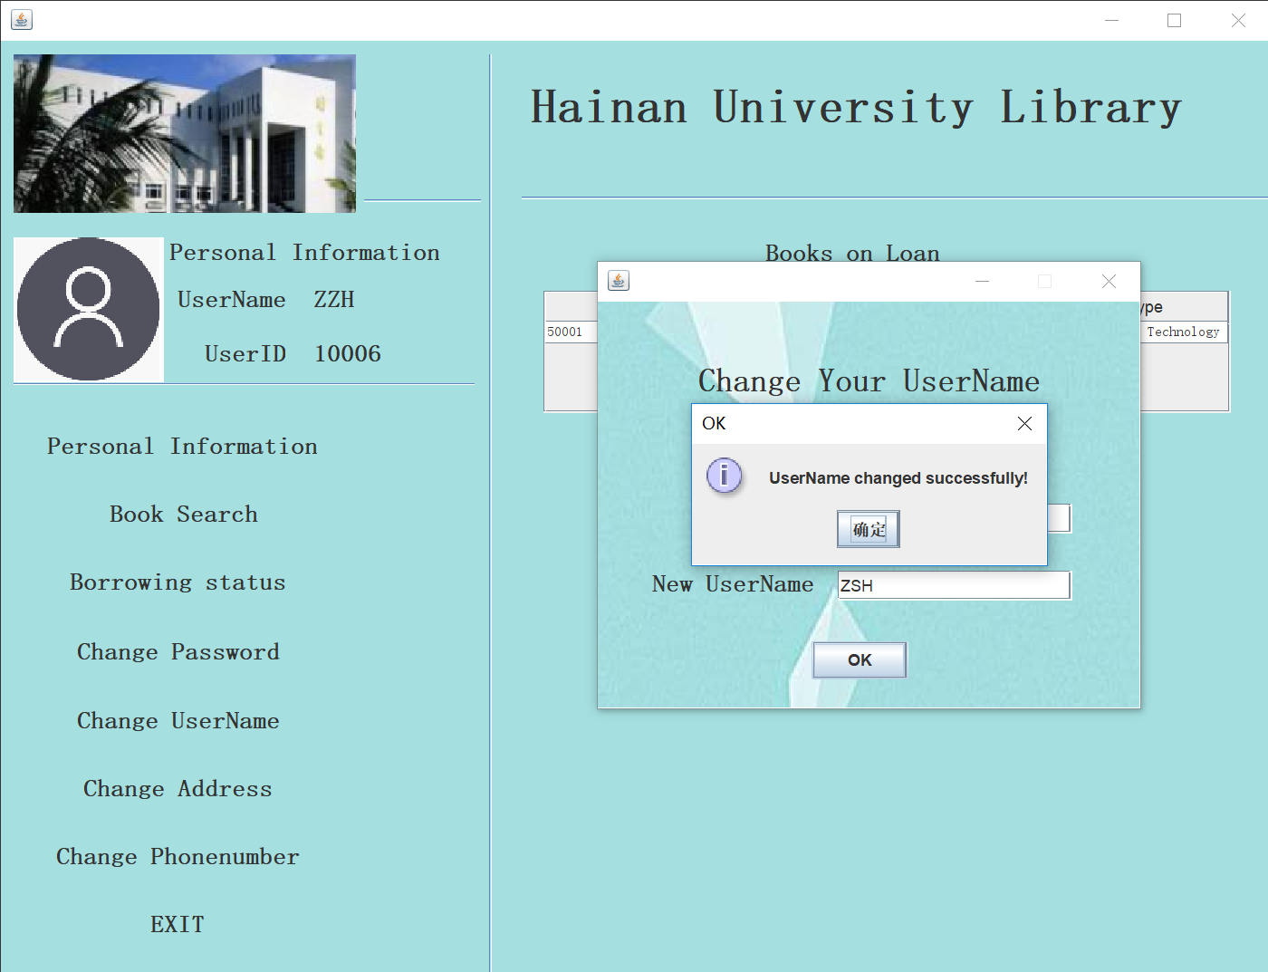
project display
Change user

Slide 40
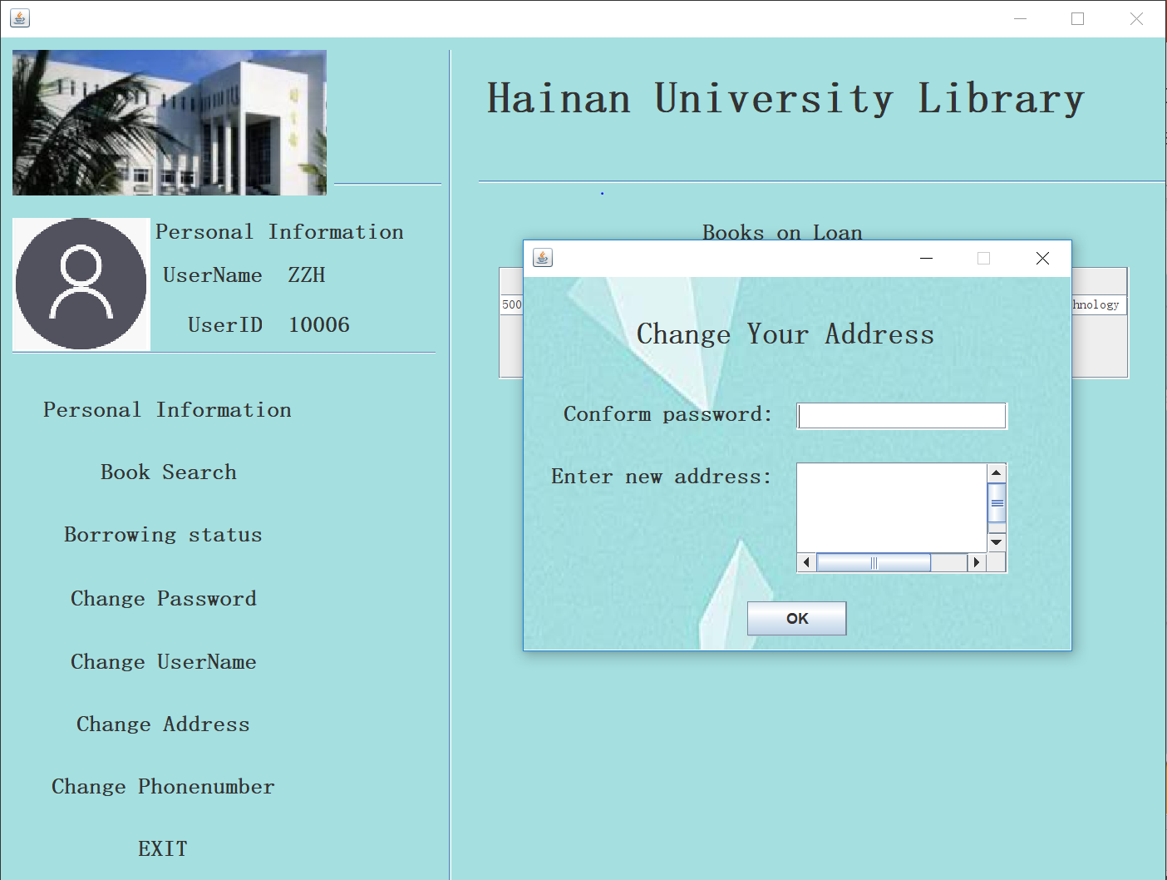
project display
Change address

Slide 41
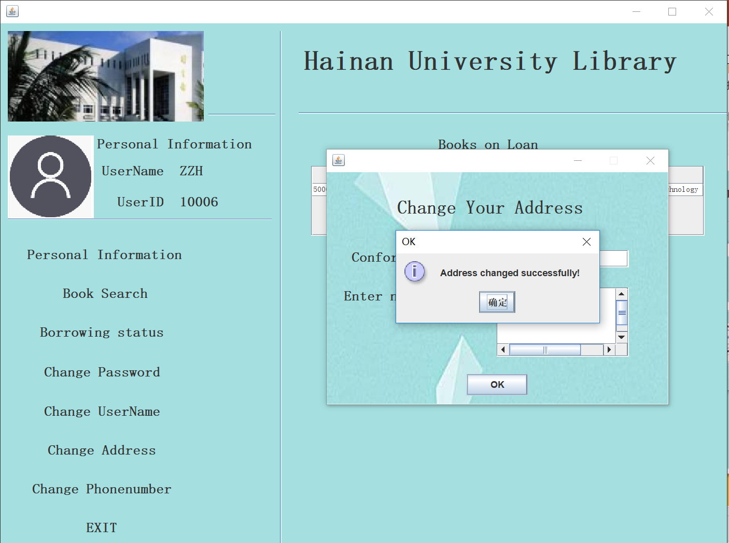
project display
Change address

Slide 42
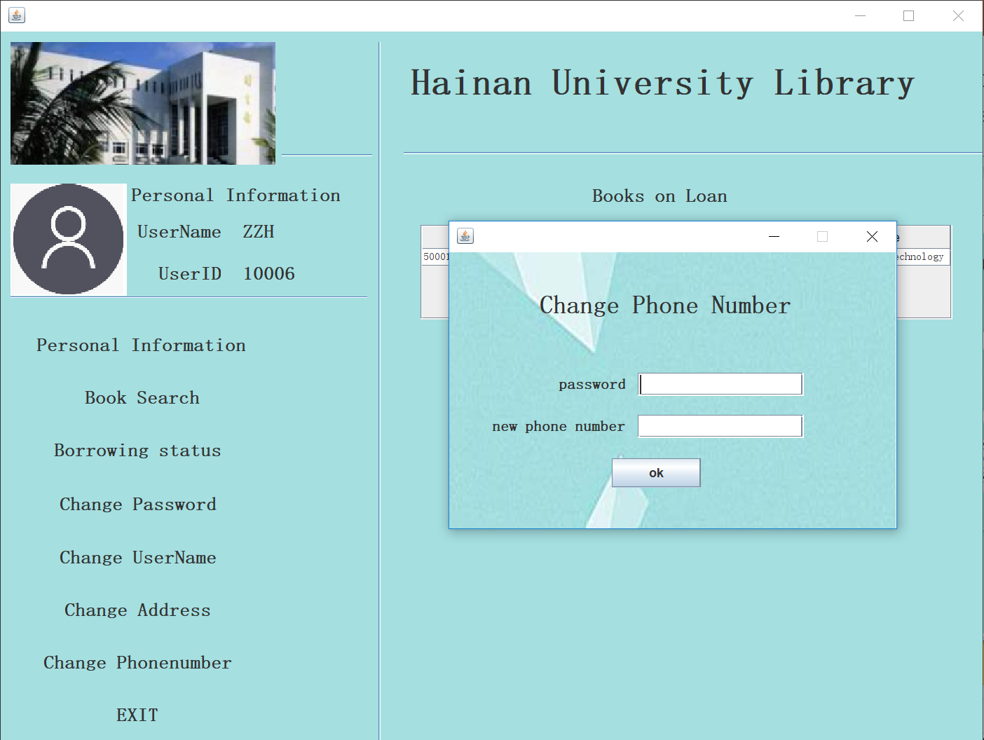
project display
Change phone number

Slide 43
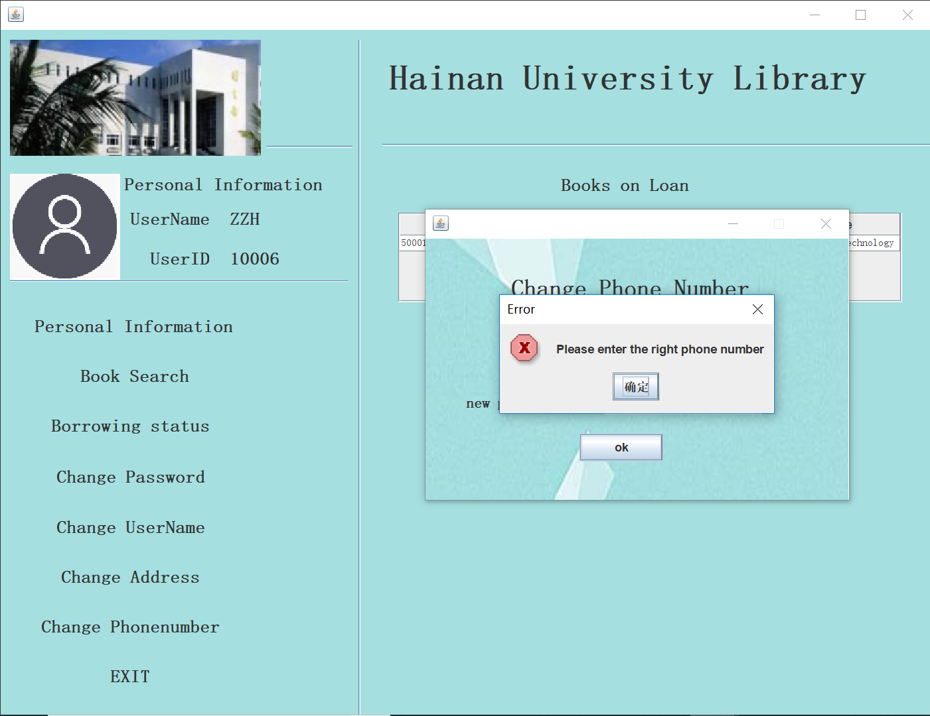
project display
Change phone number

Slide 44
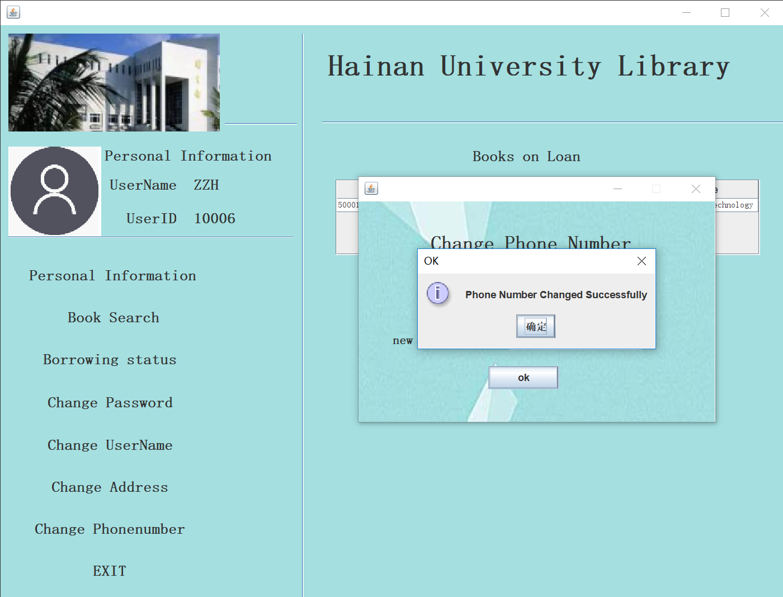
project display
Change phone number

Slide 45
Thank you！

